Slide 1

Notes:
Source: Pearson Edexcel GCSE (9-1) Design and Technology, uploaded reference PDF, printed pages 23–26, 45 and 48. Sections 1.6 Electronic systems, 1.7 Programmable components, systems thinking and system diagrams. Lesson 2 is a classroom application of these concepts. Illustrations are generated conceptual teaching visuals, not wiring instructions. Higher sensor reading means brighter light only in the stated planning example; actual sensor behaviour requires checking.

Slide 2
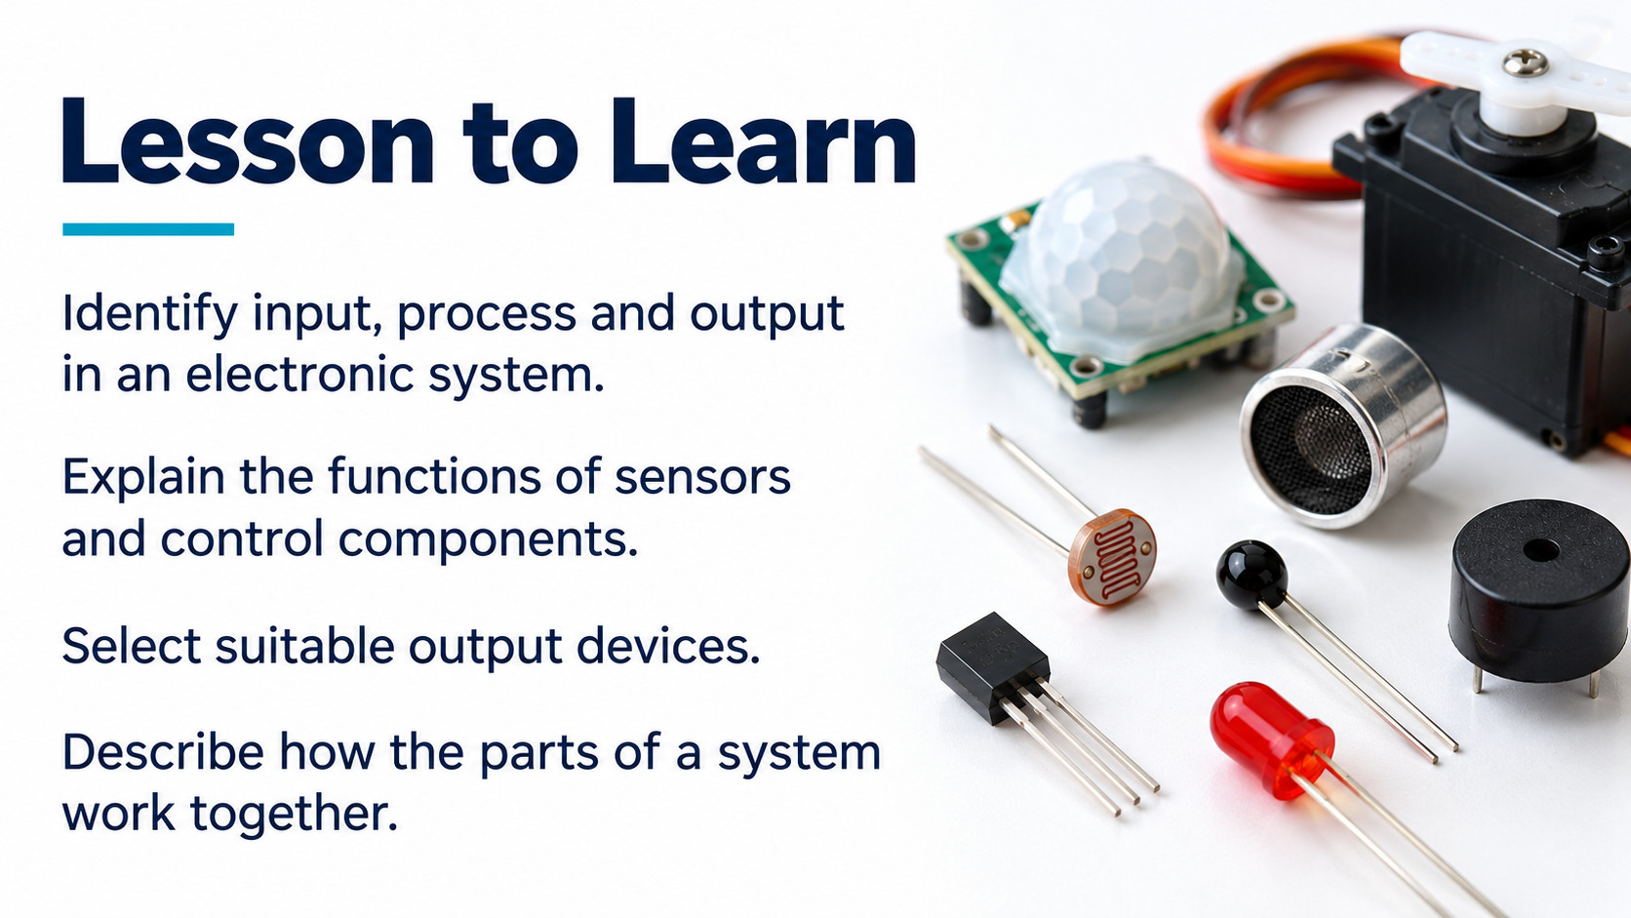
Notes:
Source: Pearson Edexcel GCSE (9-1) Design and Technology, uploaded reference PDF, printed pages 23–26, 45 and 48. Sections 1.6 Electronic systems, 1.7 Programmable components, systems thinking and system diagrams. Lesson 2 is a classroom application of these concepts. Illustrations are generated conceptual teaching visuals, not wiring instructions. Higher sensor reading means brighter light only in the stated planning example; actual sensor behaviour requires checking.

Slide 3

Notes:
Source: Pearson Edexcel GCSE (9-1) Design and Technology, uploaded reference PDF, printed pages 23–26, 45 and 48. Sections 1.6 Electronic systems, 1.7 Programmable components, systems thinking and system diagrams. Lesson 2 is a classroom application of these concepts. Illustrations are generated conceptual teaching visuals, not wiring instructions. Higher sensor reading means brighter light only in the stated planning example; actual sensor behaviour requires checking.

Slide 4
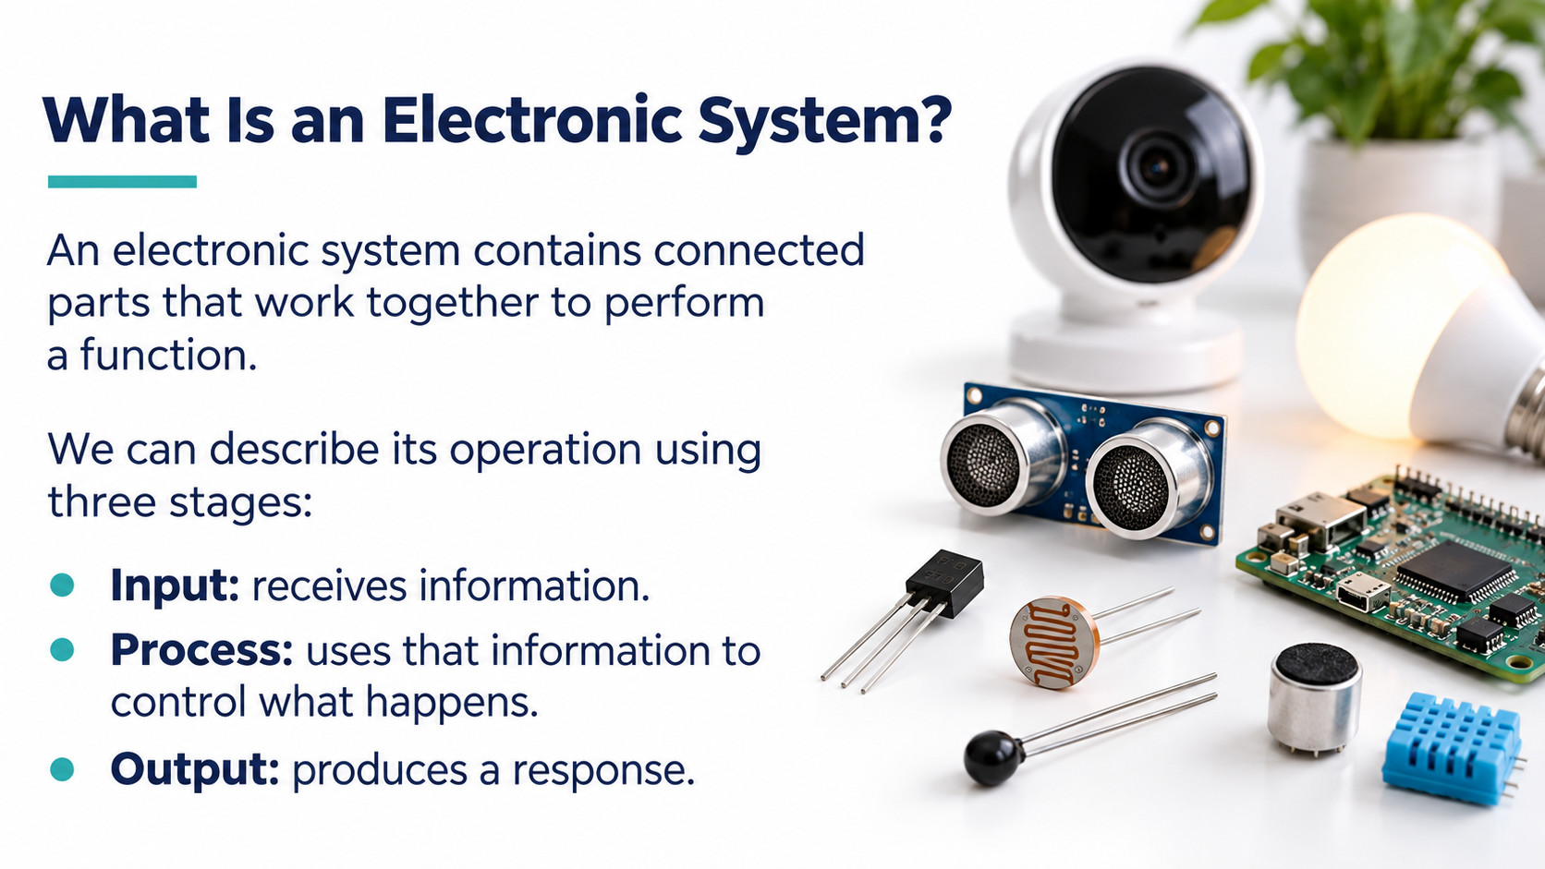
Notes:
Source: Pearson Edexcel GCSE (9-1) Design and Technology, uploaded reference PDF, printed pages 23–26, 45 and 48. Sections 1.6 Electronic systems, 1.7 Programmable components, systems thinking and system diagrams. Lesson 2 is a classroom application of these concepts. Illustrations are generated conceptual teaching visuals, not wiring instructions. Higher sensor reading means brighter light only in the stated planning example; actual sensor behaviour requires checking.

Slide 5
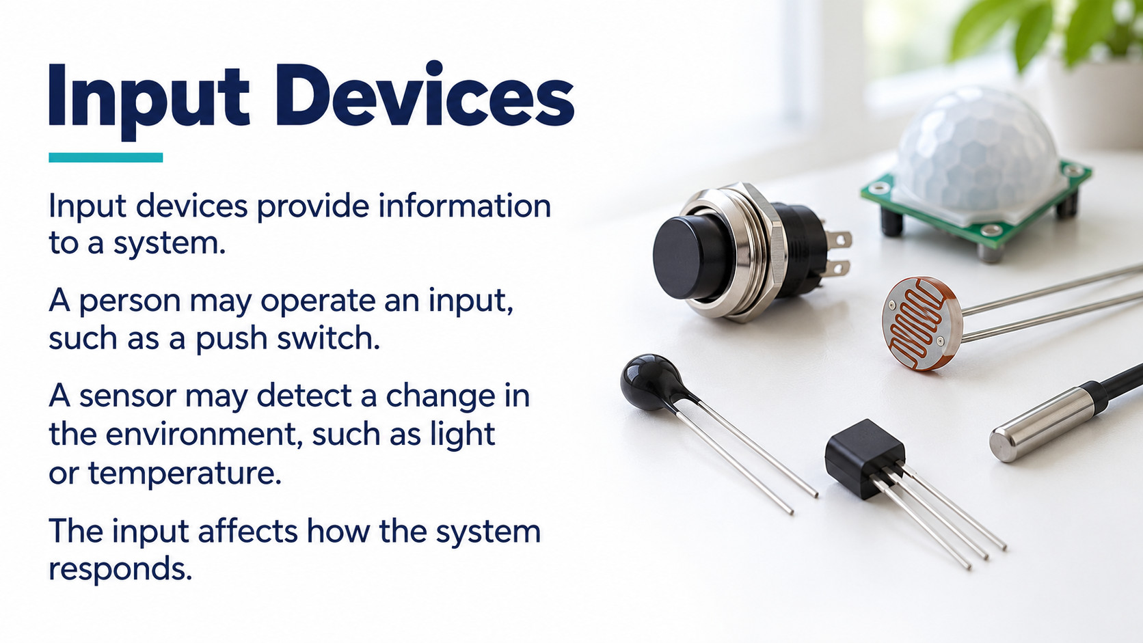
Notes:
Source: Pearson Edexcel GCSE (9-1) Design and Technology, uploaded reference PDF, printed pages 23–26, 45 and 48. Sections 1.6 Electronic systems, 1.7 Programmable components, systems thinking and system diagrams. Lesson 2 is a classroom application of these concepts. Illustrations are generated conceptual teaching visuals, not wiring instructions. Higher sensor reading means brighter light only in the stated planning example; actual sensor behaviour requires checking.

Slide 6
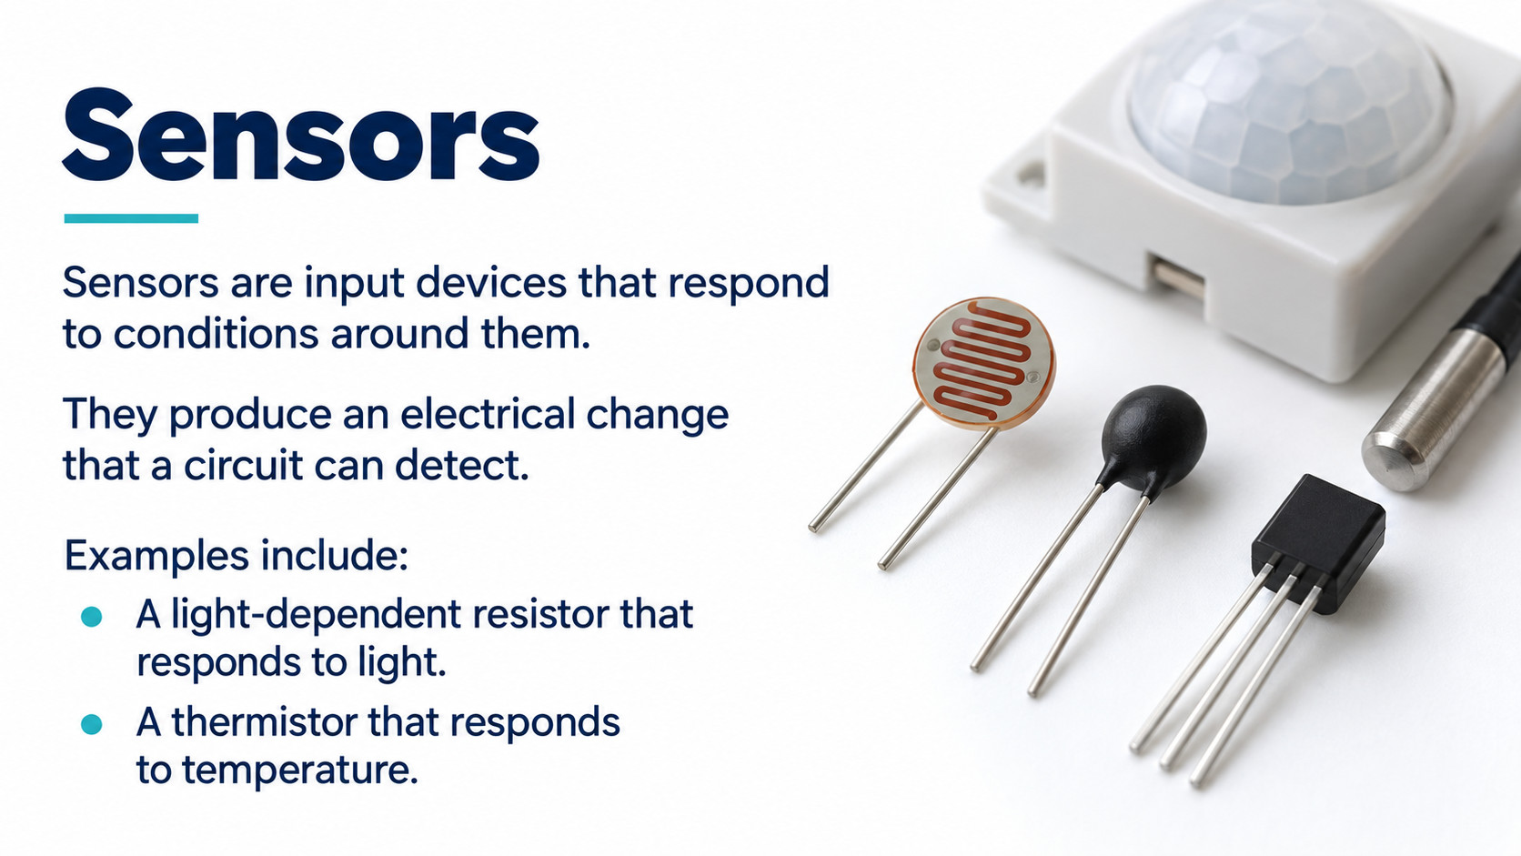
Notes:
Source: Pearson Edexcel GCSE (9-1) Design and Technology, uploaded reference PDF, printed pages 23–26, 45 and 48. Sections 1.6 Electronic systems, 1.7 Programmable components, systems thinking and system diagrams. Lesson 2 is a classroom application of these concepts. Illustrations are generated conceptual teaching visuals, not wiring instructions. Higher sensor reading means brighter light only in the stated planning example; actual sensor behaviour requires checking.

Slide 7
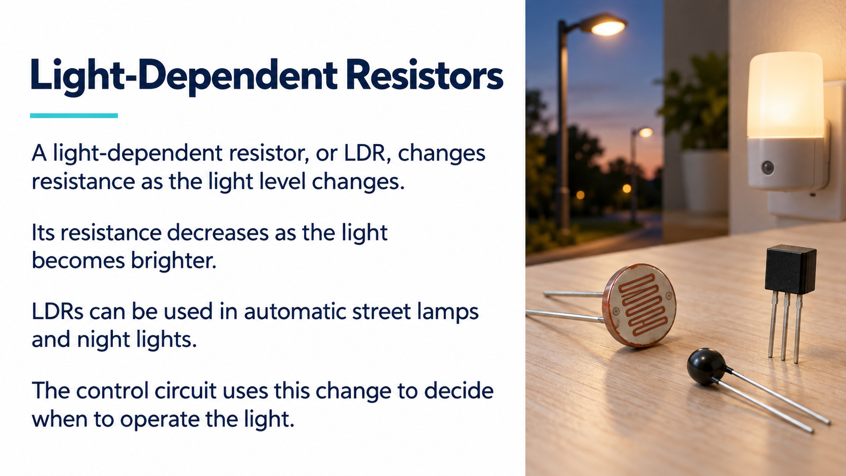
Notes:
Source: Pearson Edexcel GCSE (9-1) Design and Technology, uploaded reference PDF, printed pages 23–26, 45 and 48. Sections 1.6 Electronic systems, 1.7 Programmable components, systems thinking and system diagrams. Lesson 2 is a classroom application of these concepts. Illustrations are generated conceptual teaching visuals, not wiring instructions. Higher sensor reading means brighter light only in the stated planning example; actual sensor behaviour requires checking.

Slide 8
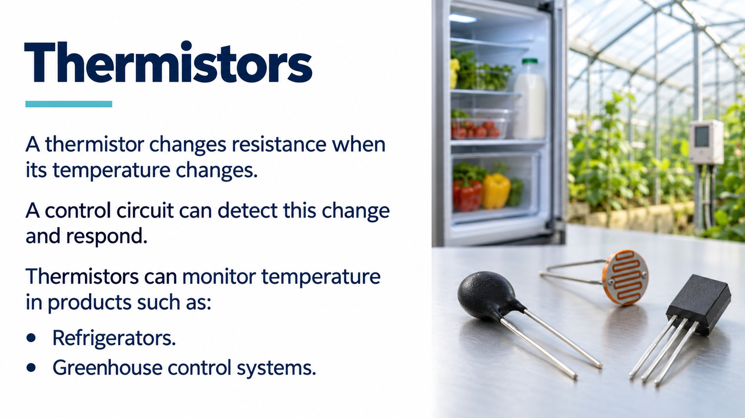
Notes:
Source: Pearson Edexcel GCSE (9-1) Design and Technology, uploaded reference PDF, printed pages 23–26, 45 and 48. Sections 1.6 Electronic systems, 1.7 Programmable components, systems thinking and system diagrams. Lesson 2 is a classroom application of these concepts. Illustrations are generated conceptual teaching visuals, not wiring instructions. Higher sensor reading means brighter light only in the stated planning example; actual sensor behaviour requires checking.

Slide 9

Notes:
Source: Pearson Edexcel GCSE (9-1) Design and Technology, uploaded reference PDF, printed pages 23–26, 45 and 48. Sections 1.6 Electronic systems, 1.7 Programmable components, systems thinking and system diagrams. Lesson 2 is a classroom application of these concepts. Illustrations are generated conceptual teaching visuals, not wiring instructions. Higher sensor reading means brighter light only in the stated planning example; actual sensor behaviour requires checking.

Slide 10
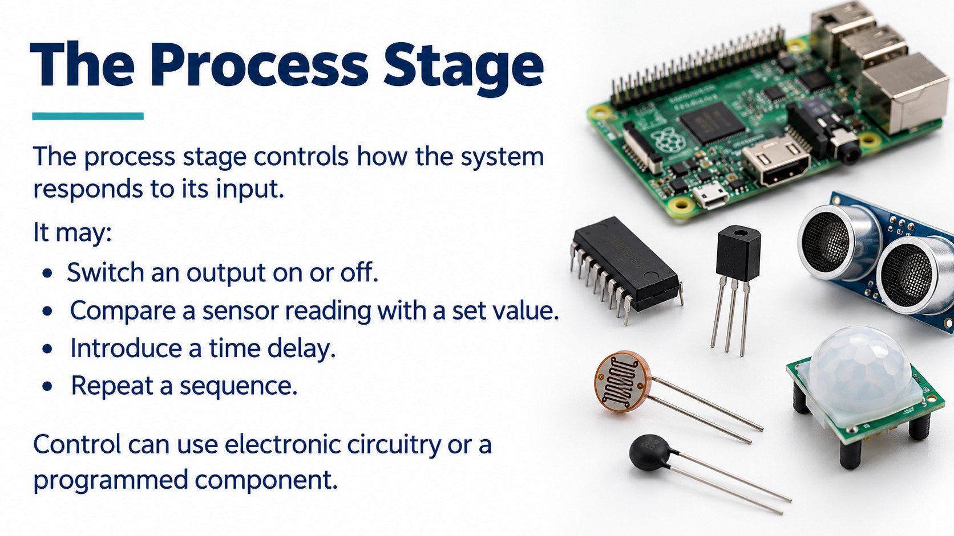
Notes:
Source: Pearson Edexcel GCSE (9-1) Design and Technology, uploaded reference PDF, printed pages 23–26, 45 and 48. Sections 1.6 Electronic systems, 1.7 Programmable components, systems thinking and system diagrams. Lesson 2 is a classroom application of these concepts. Illustrations are generated conceptual teaching visuals, not wiring instructions. Higher sensor reading means brighter light only in the stated planning example; actual sensor behaviour requires checking.

Slide 11
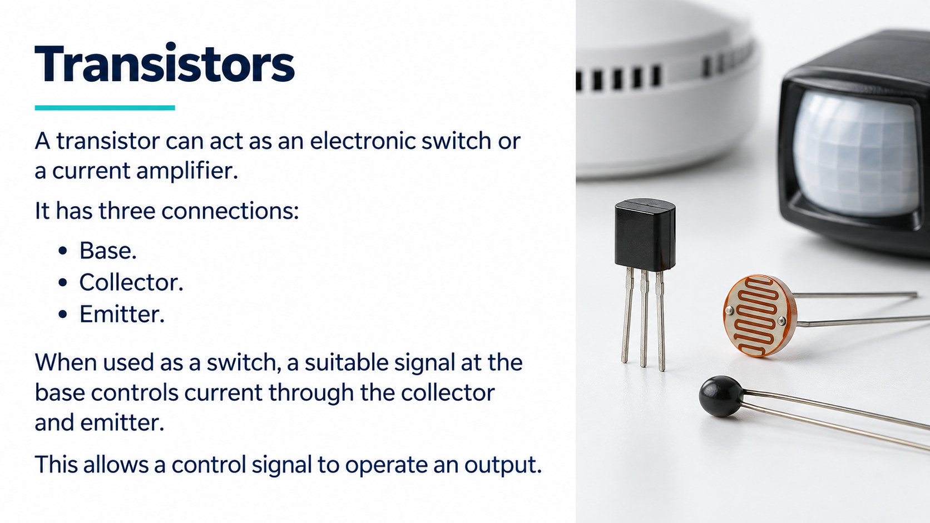
Notes:
Source: Pearson Edexcel GCSE (9-1) Design and Technology, uploaded reference PDF, printed pages 23–26, 45 and 48. Sections 1.6 Electronic systems, 1.7 Programmable components, systems thinking and system diagrams. Lesson 2 is a classroom application of these concepts. Illustrations are generated conceptual teaching visuals, not wiring instructions. Higher sensor reading means brighter light only in the stated planning example; actual sensor behaviour requires checking.

Slide 12
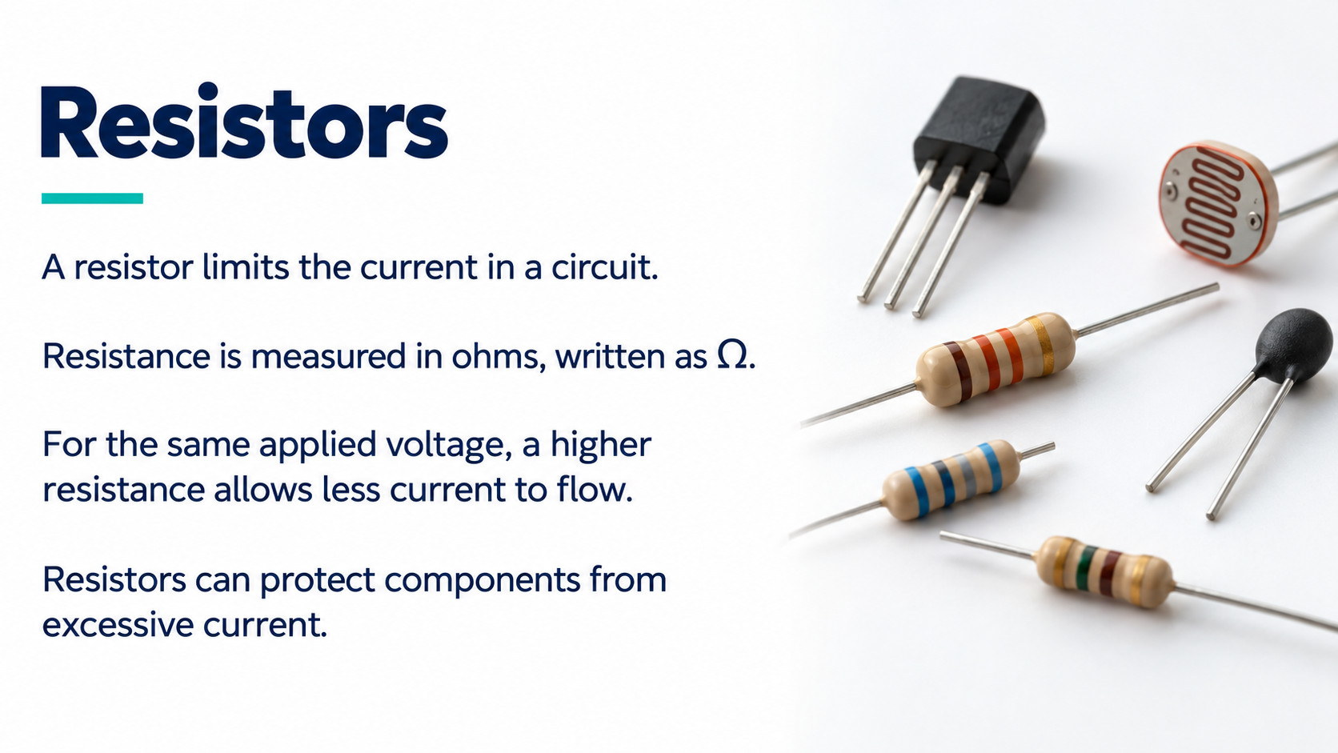
Notes:
Source: Pearson Edexcel GCSE (9-1) Design and Technology, uploaded reference PDF, printed pages 23–26, 45 and 48. Sections 1.6 Electronic systems, 1.7 Programmable components, systems thinking and system diagrams. Lesson 2 is a classroom application of these concepts. Illustrations are generated conceptual teaching visuals, not wiring instructions. Higher sensor reading means brighter light only in the stated planning example; actual sensor behaviour requires checking.

Slide 13
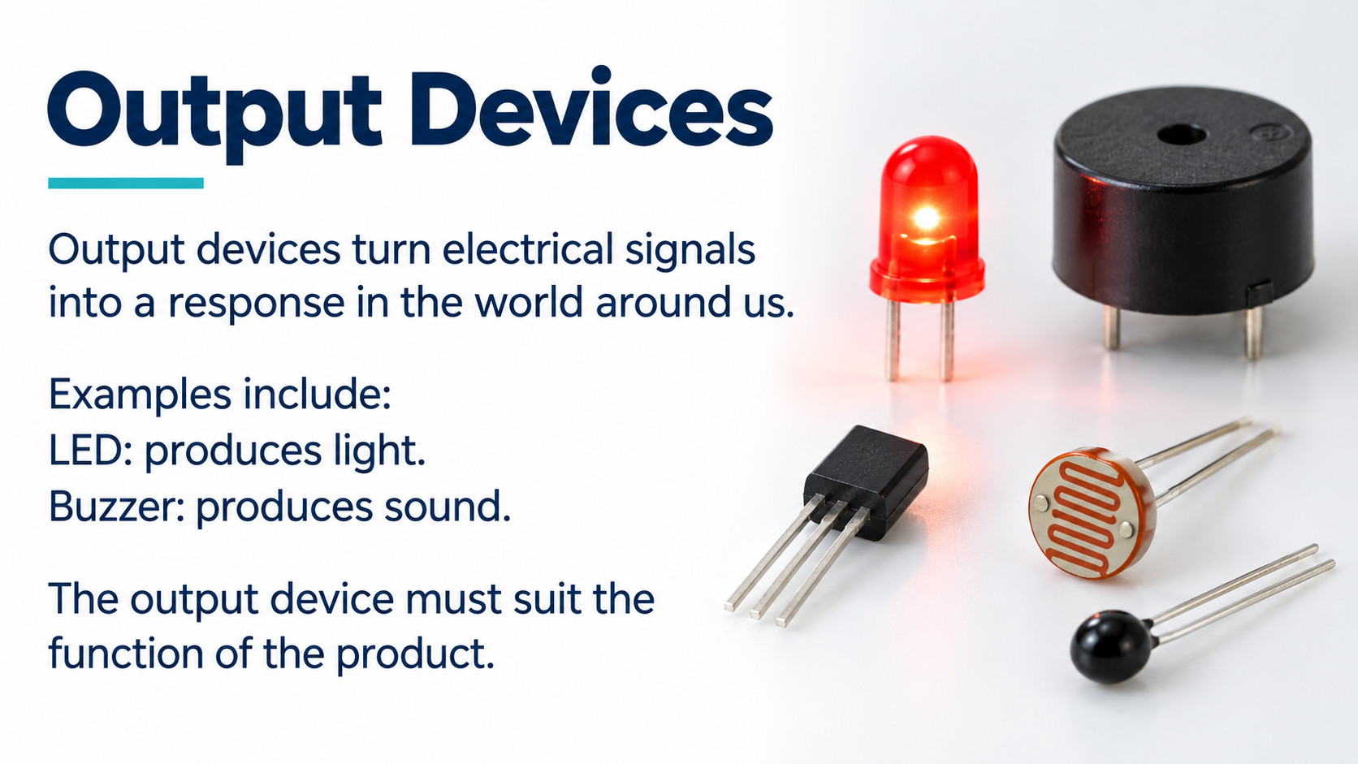
Notes:
Source: Pearson Edexcel GCSE (9-1) Design and Technology, uploaded reference PDF, printed pages 23–26, 45 and 48. Sections 1.6 Electronic systems, 1.7 Programmable components, systems thinking and system diagrams. Lesson 2 is a classroom application of these concepts. Illustrations are generated conceptual teaching visuals, not wiring instructions. Higher sensor reading means brighter light only in the stated planning example; actual sensor behaviour requires checking.

Slide 14
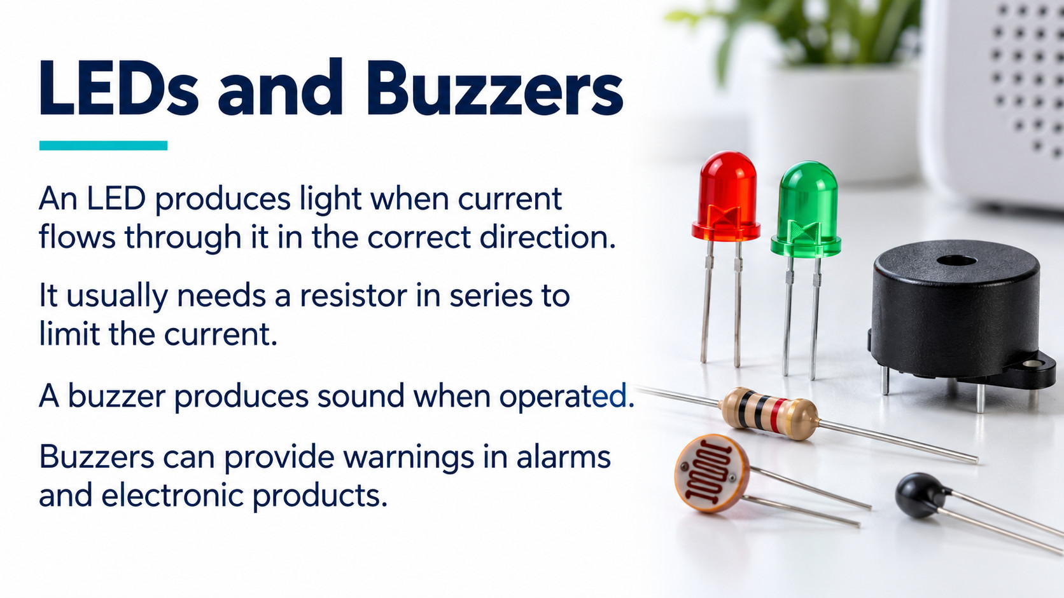
Notes:
Source: Pearson Edexcel GCSE (9-1) Design and Technology, uploaded reference PDF, printed pages 23–26, 45 and 48. Sections 1.6 Electronic systems, 1.7 Programmable components, systems thinking and system diagrams. Lesson 2 is a classroom application of these concepts. Illustrations are generated conceptual teaching visuals, not wiring instructions. Higher sensor reading means brighter light only in the stated planning example; actual sensor behaviour requires checking.

Slide 15
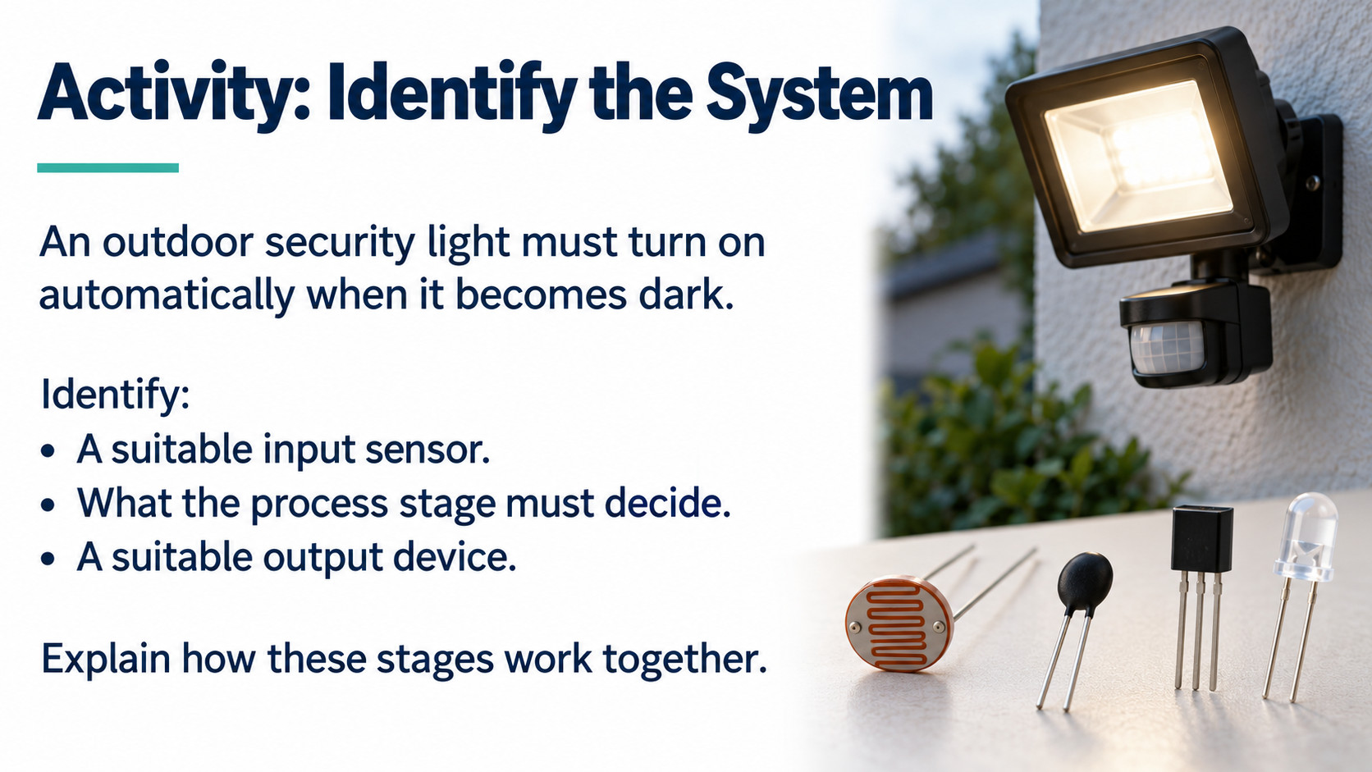
Notes:
Source: Pearson Edexcel GCSE (9-1) Design and Technology, uploaded reference PDF, printed pages 23–26, 45 and 48. Sections 1.6 Electronic systems, 1.7 Programmable components, systems thinking and system diagrams. Lesson 2 is a classroom application of these concepts. Illustrations are generated conceptual teaching visuals, not wiring instructions. Higher sensor reading means brighter light only in the stated planning example; actual sensor behaviour requires checking.

Slide 16
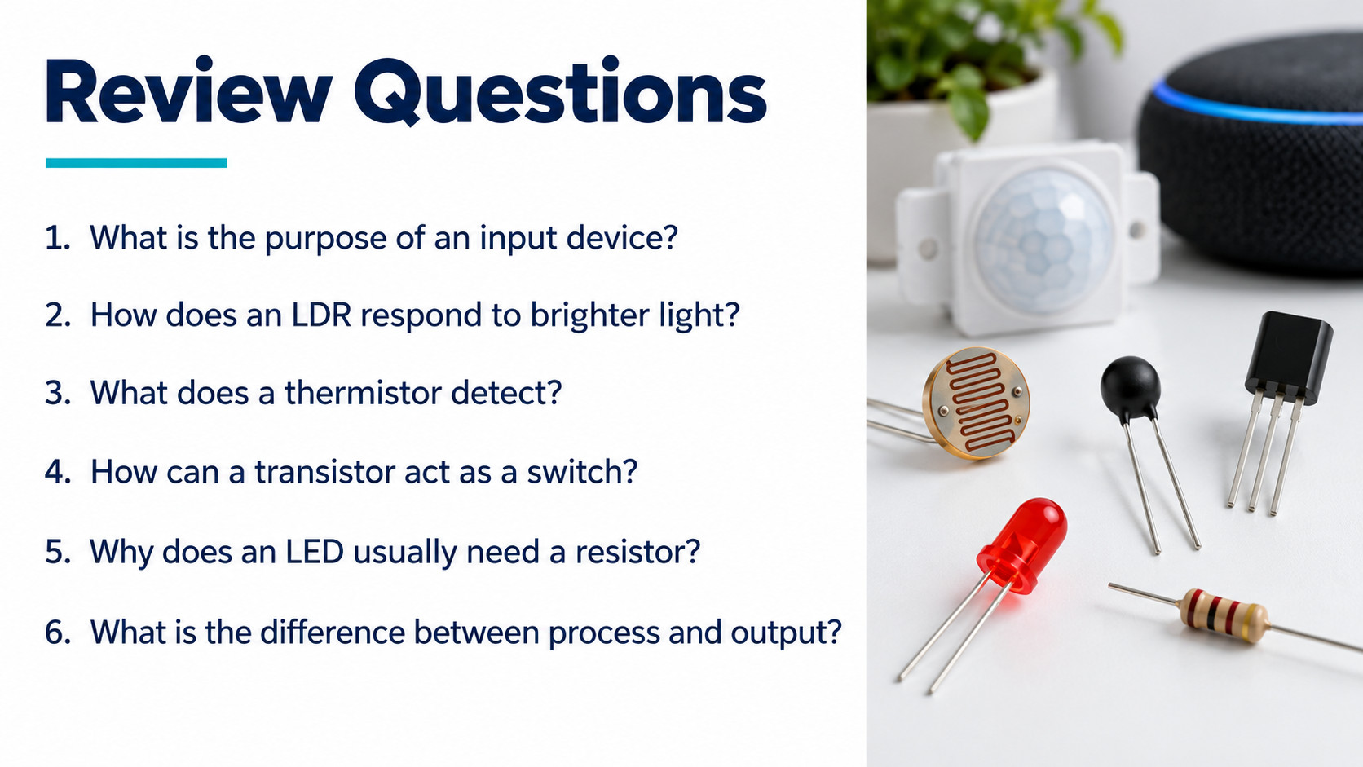
Notes:
Source: Pearson Edexcel GCSE (9-1) Design and Technology, uploaded reference PDF, printed pages 23–26, 45 and 48. Sections 1.6 Electronic systems, 1.7 Programmable components, systems thinking and system diagrams. Lesson 2 is a classroom application of these concepts. Illustrations are generated conceptual teaching visuals, not wiring instructions. Higher sensor reading means brighter light only in the stated planning example; actual sensor behaviour requires checking.

